Slide 1
Contract Monthly Claims System
ST10457761 – Sujendran Reddy POE Part 3

Slide 2






Objectives – Focus areas in Part 3
HR super-user role
Lecturer claim improvements
EF database integration
Role enforcement for Coordinator and Manager
PDF reporting (HR)
Security and UI improvements

Slide 3
Improvements from Part 2
Key Improvements :
Added HR as super-user: creates users, edits users, generates PDF reports.
Removed public registration; HR creates all accounts.
Lecturers: login added, hourly rate auto-filled, total auto-calculated, monthly
hour validation.
Claims stored in EF; lecturers only see their own claims.
Coordinator verifies claims; Manager sees only verified claims.
Added roles, authorization rules, and session usage.
Locked down pages so users can only access their allowed views

Slide 4
Feedback from Part 2
Feedback: The design of the view is highly intuitive and well-structured, enhancing the verification process significantly. Managers should only see claims that have been verified.
Response:
Managers can now only see verified claims instead of claims that have yet to be verified or rejected.

Slide 5
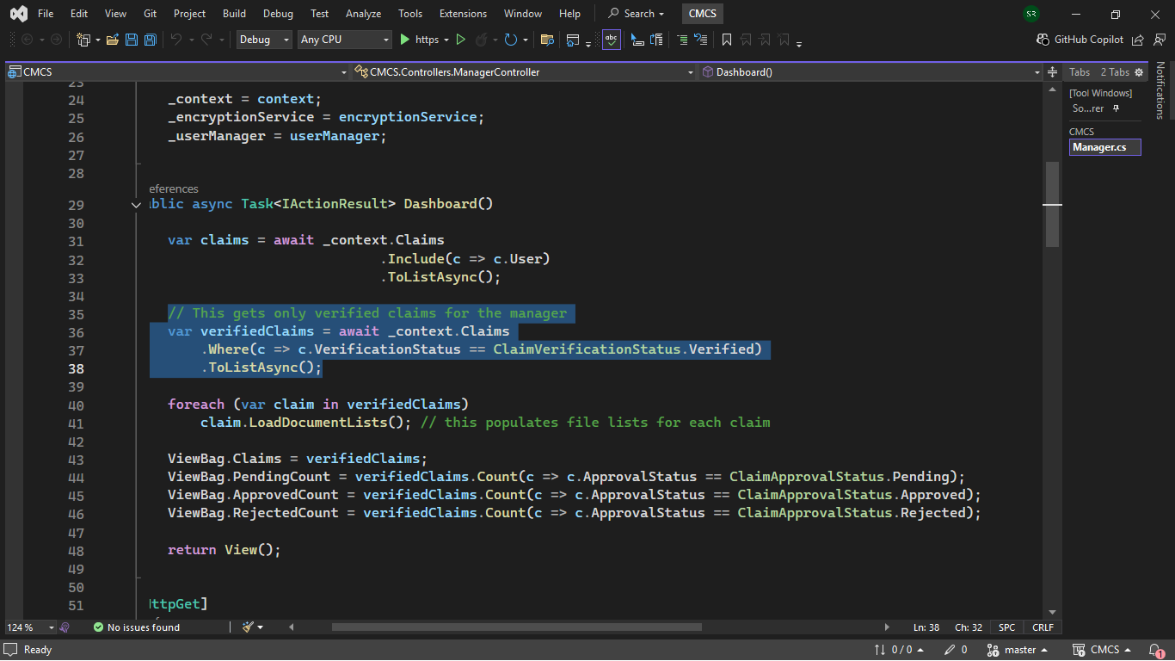
Manager Controller

Slide 6
Code Explanation
context.claims - Accesses the Claims table in the database.
Where(c =>……………..Verified) - Filters the records so only the claims that have been verified are selected.
.ToListAsync() – This executes the query and returns the results.

Slide 7
HR Super User Role
HR can:
Create all users (name, surname, email, hourly rate, max hours)
Edit/update all user information
Generate PDF reports or invoices using PdfSharpCore
Reports can filter by date and status or generate all claims at once

Slide 8
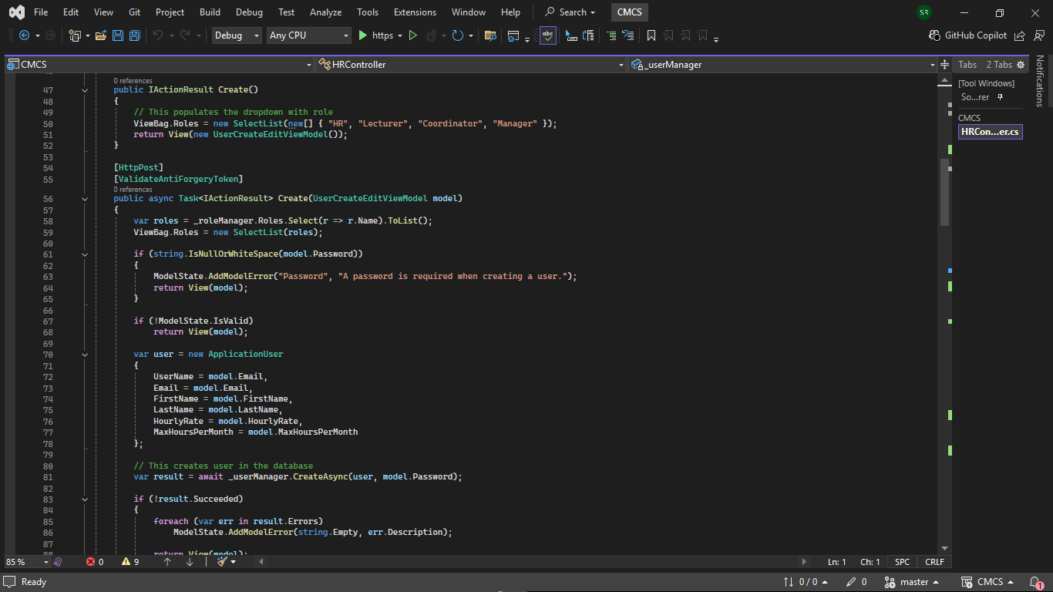
HR Controller

Slide 9
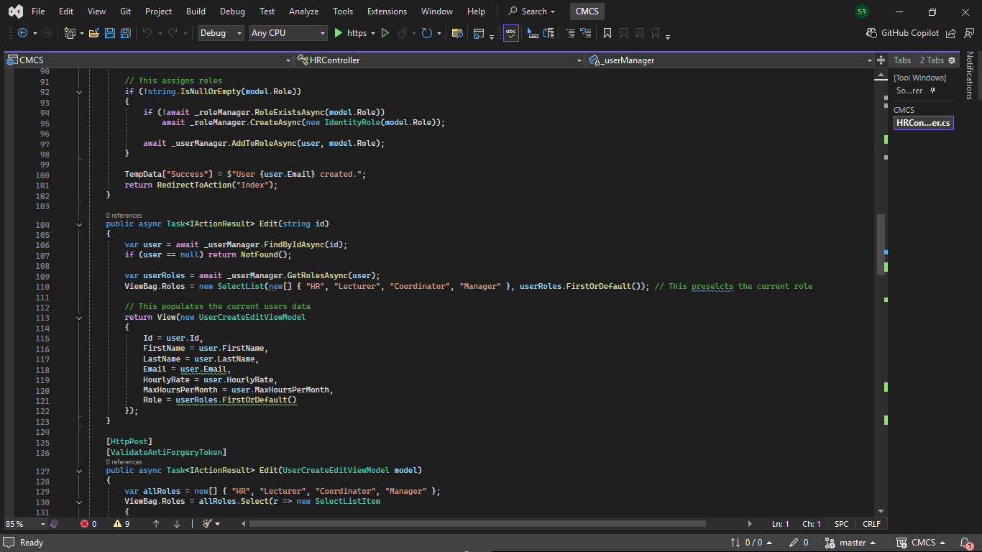
HR Controller

Slide 10
Code Explanation
var roles = _roleManager.Roles.Select(r => r.Name).ToList(); Fetches all roles from Identity and send them to the view.
if (string.IsNullOrWhiteSpace(model.Password)) Prevents creating a user with an empty password.
var result = await _userManager.CreateAsync(user, model.Password); Inserts the user into the AspNetUsers table.

Slide 11
Code Explanation
if (!await _roleManager.RoleExistsAsync(model.Role))
await _roleManager.CreateAsync(new IdentityRole(model.Role)); await _userManager.AddToRoleAsync(user, model.Role);
Checks if the selected roles exist and adds the user to that role.

Slide 12
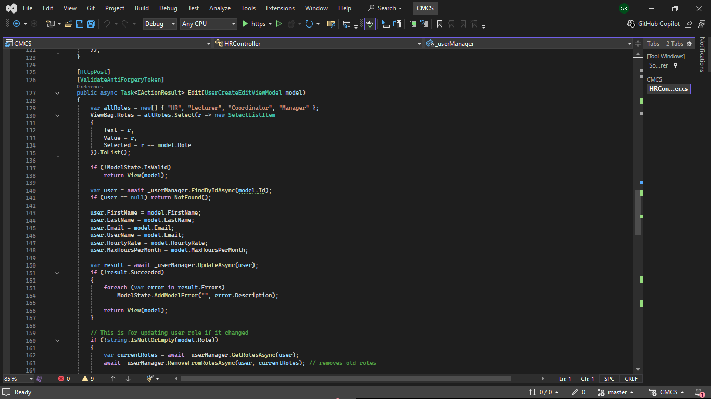
HR Controller

Slide 13
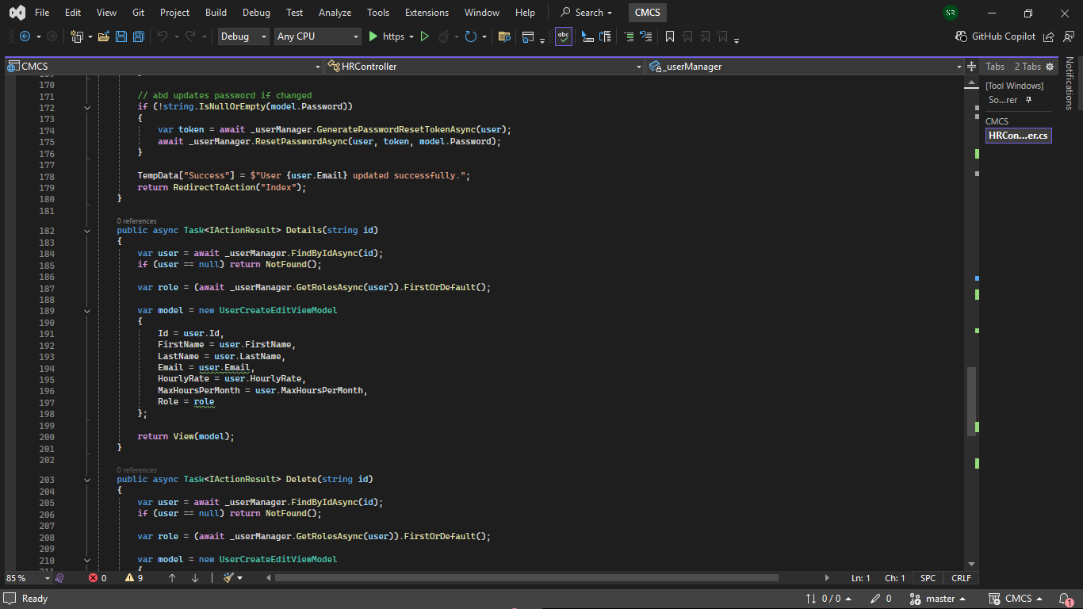
HR Controller

Slide 14
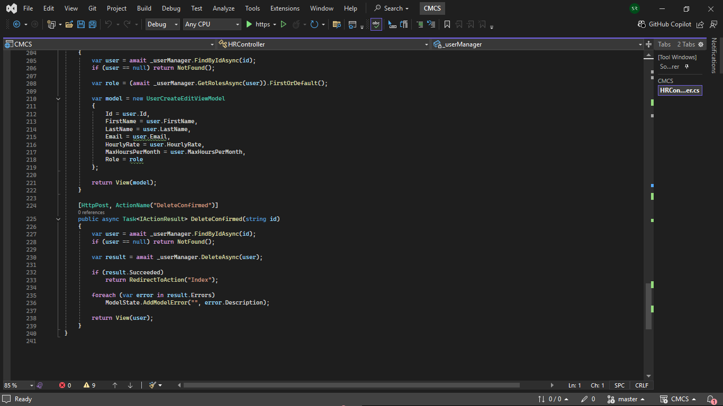
HR Controller

Slide 15
Code Explanation
var roles = await _userManager.GetRolesAsync(user); model.Add(new UserCreateEditViewModel { ... Role = roles.FirstOrDefault() }); Fetches the user’s assigned role from identity. Converts to a ViewModel.
ViewBag.Roles = new SelectList(new[] { "HR", "Lecturer", "Coordinator", "Manager" }); Populates the create/edit with available roles.

Slide 16
Code Explanation
var result = await _userManager.CreateAsync(user, model.Password); Inserts the new user into identity tables and peforms password hashing and password rules.
ViewBag.Roles = new SelectList(..., userRoles.FirstOrDefault()); Shows the user’s current role selected.

Slide 17
Code Explanation
var currentRoles = await _userManager.GetRolesAsync(user); await _userManager.RemoveFromRolesAsync(user, currentRoles); await _userManager.AddToRoleAsync(user, model.Role); ViewBag.Roles = new SelectList(..., userRoles.FirstOrDefault()); Shows the user’s current role selected. Removes all existing roles from the user, adds the newly selected role, ensures the user has exactly 1 role.

Slide 18
Code Explanation
var token = await _userManager.GeneratePasswordResetTokenAsync(user); await _userManager.ResetPasswordAsync(user, token, model.Password); Identity needs a reset token to change the password. This updates the password without needing the old one.

Slide 19
Lecturer Claim Improvements
Auto-populates: Name, Surname, Hourly Rate (from HR)
Only inputs: Hours worked, documentation, and month.
Auto-calculation in Claim model:
public decimal TotalAmount => HoursWorked * HourlyRate;
Validation: Prevents exceeding monthly limit. Example:
Max hours = 8, entered = 9 → message: “You have exceeded your monthly limit. You will only be paid for the remaining hours allowed: {remainingAllowed}.”
EF database storage – The all fields are stored in the local database.

Slide 20
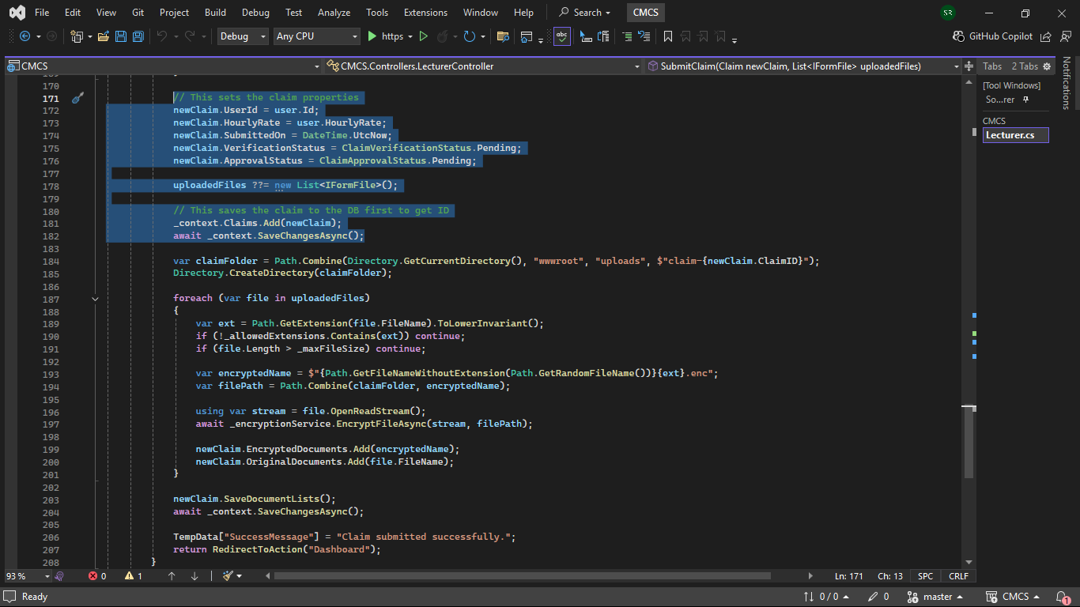
Lecturer Controller – Auto populate

Slide 21
Code Explanation
The highlighted code links the claim to the logged-in user. Populating the following: user ID, hourly rate, and submitted on. It also sets the verification and approval statuses to pending.
uploadedFiles ??= new List<IFormFile>(); If a lecturer uploads files, the files are kept; if they do not, a new empty list is set to avoid null errors.

Slide 22
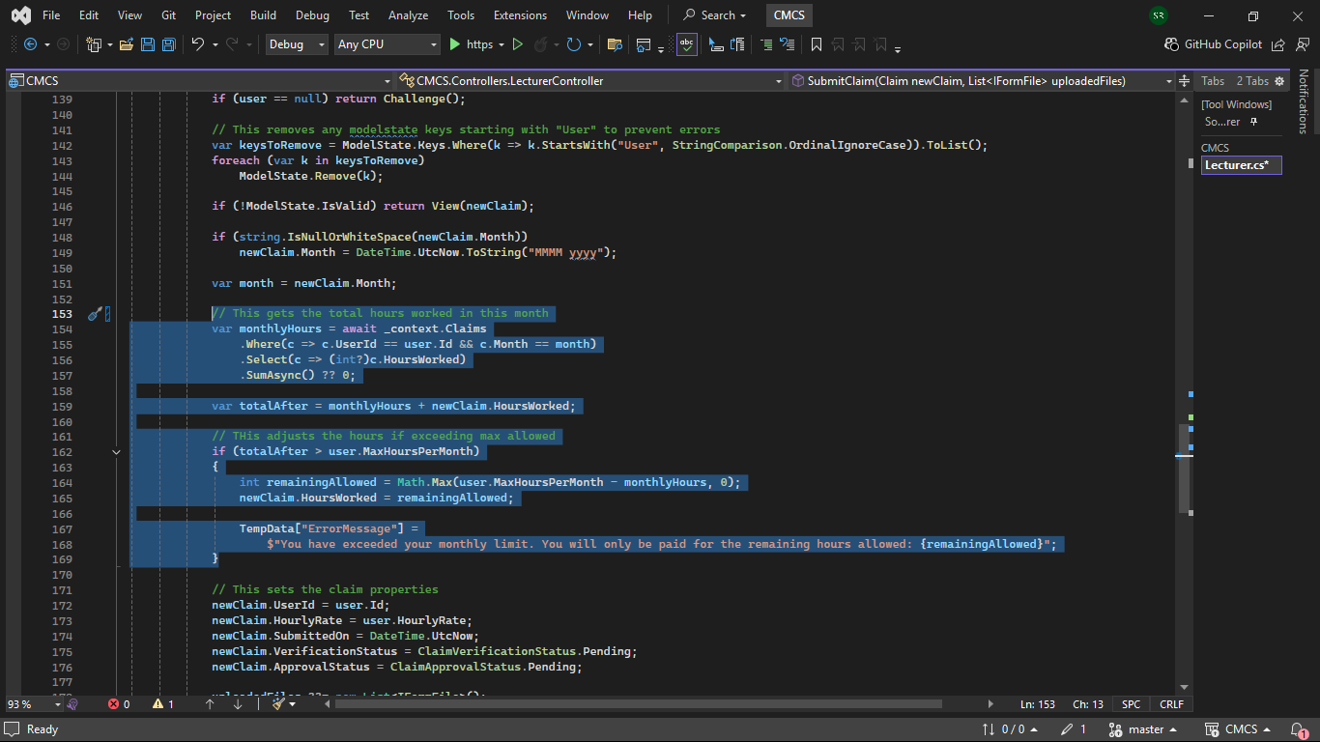
Lecturer Controller - Validation

Slide 23
Code Explanation
Calculates the total hours already worked in this month.
It then predicts the total hours after adding the new claim.
The hours are adjusted if the lecturer exceeds their monthly max.
An explanatory message is sent to the user.

Slide 24
Coordinator View
Coordinators can…
View all submitted claims
Verify or reject claims
Only authorised claims visible
Sessions enforce login persistence
Authorization prevents page access for unauthorized users

Slide 25
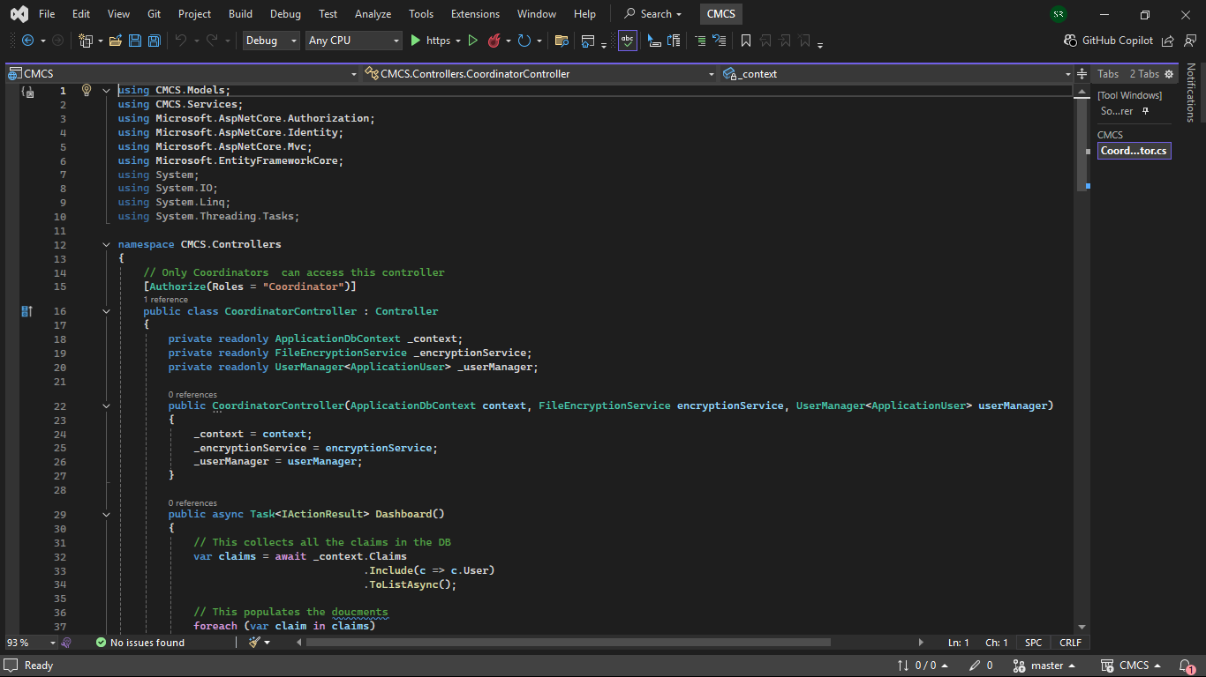
Coordinator Controller

Slide 26
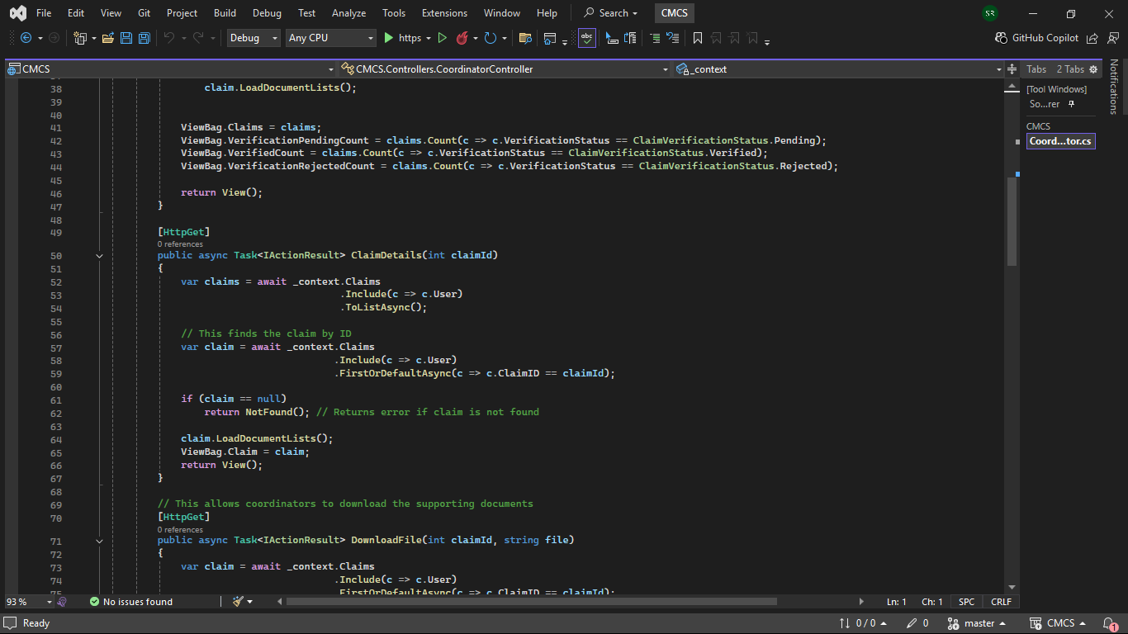
Coordinator Controller

Slide 27
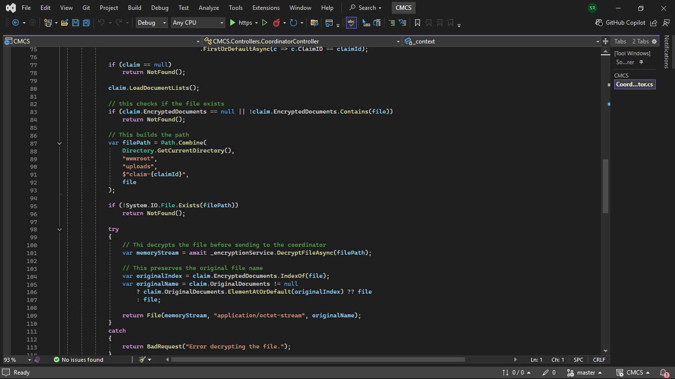
Coordinator Controller

Slide 28
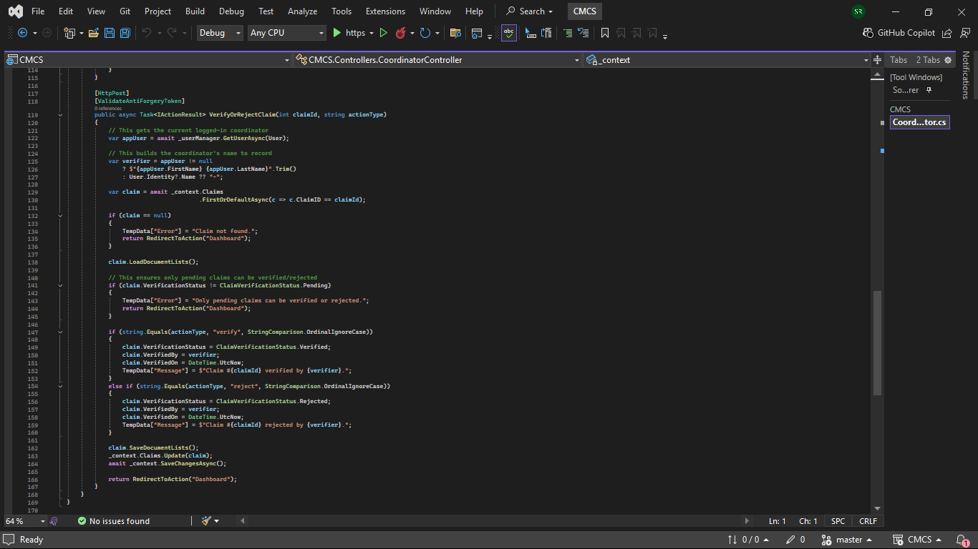
Coordinator Controller

Slide 29
Code Explanation
var verifier = appUser != null ? $"{appUser.FirstName} {appUser.LastName}".Trim() : User.Identity?.Name ?? "-"; This gets the coordinator’s full name, if it is null it uses “-” or user.identity.name.

Slide 30
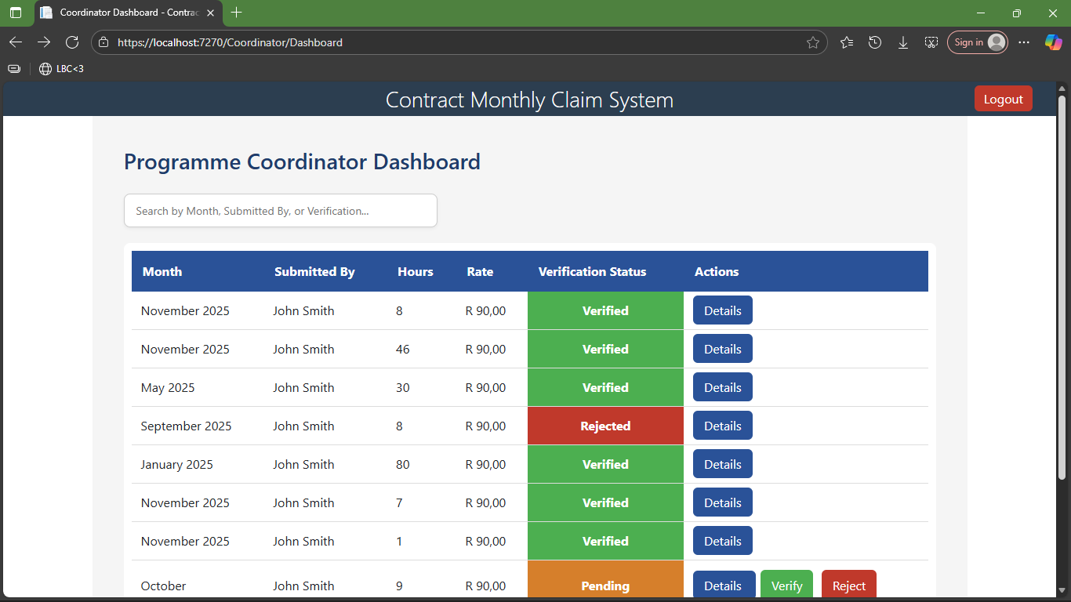
Coordinator View

Slide 31
Manager View
Manager sees only verified claims
Can view claim details, totals, and HR-generated PDFs
Authorisation enforced through roles and sessions

Slide 32
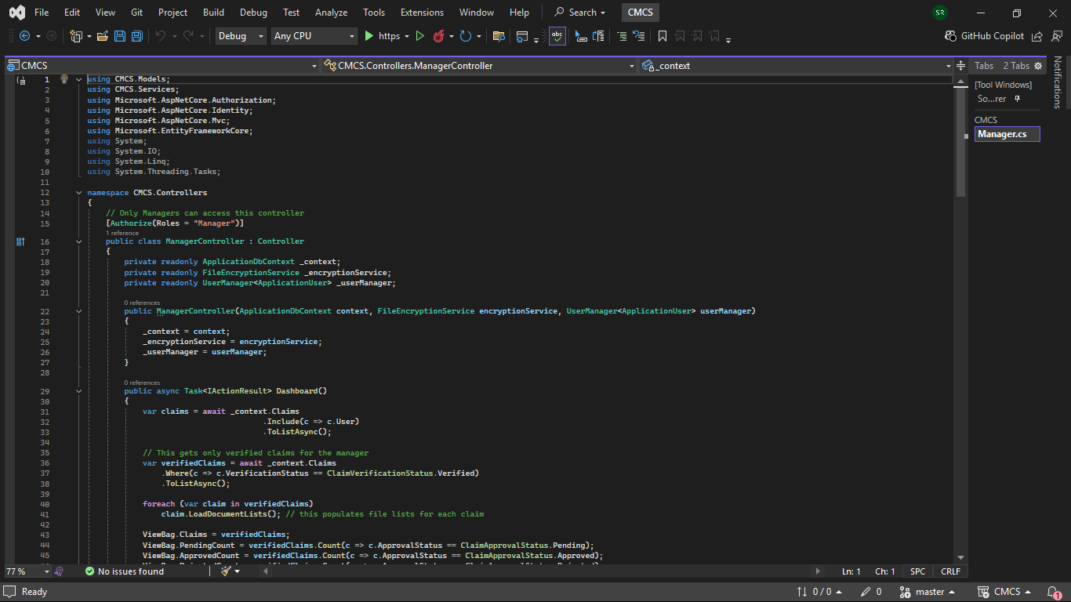
Manager Controller

Slide 33
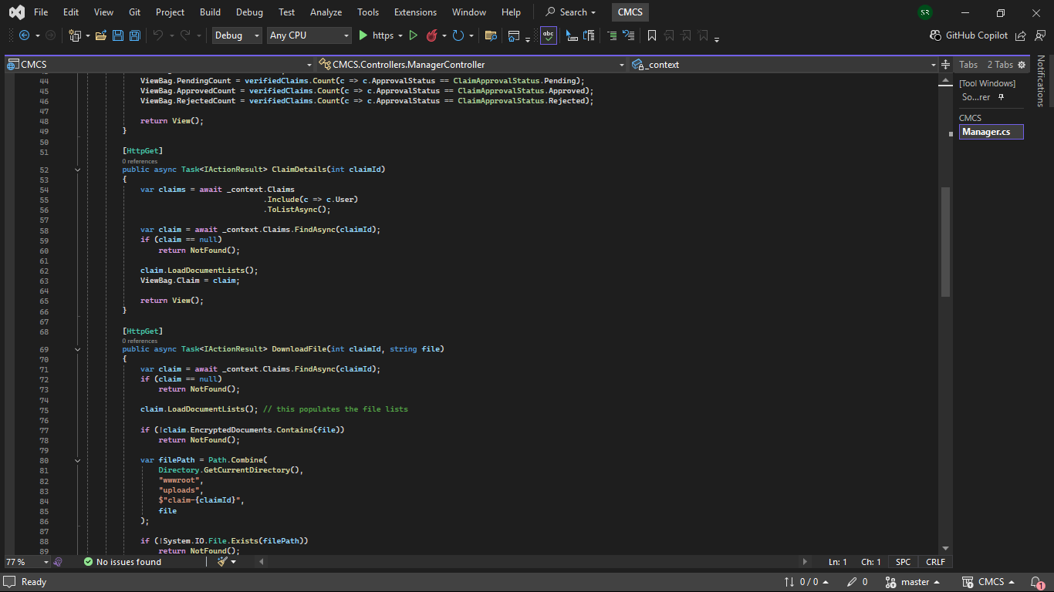
Manager Controller

Slide 34
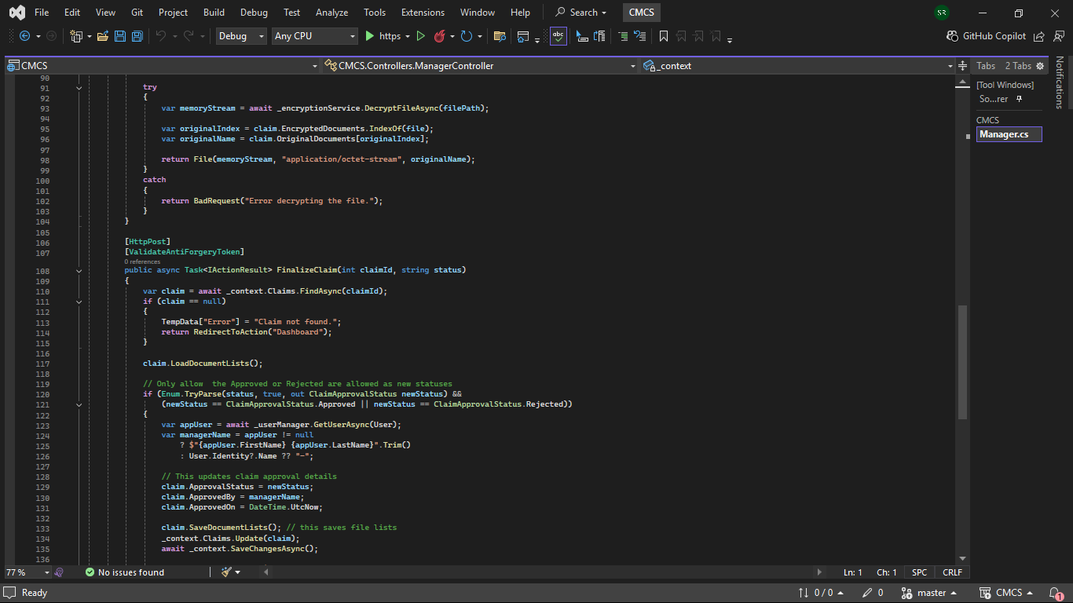
Manager Controller

Slide 35
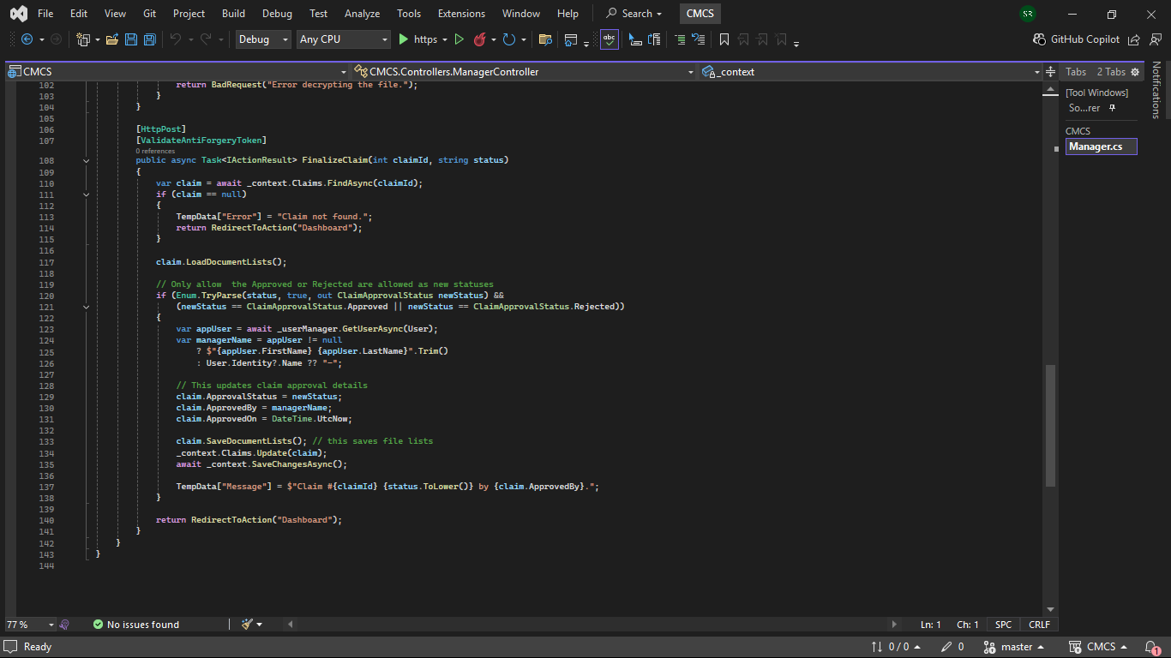
Manager Controller

Slide 36
Code Explanation
var verifiedClaims = await _context.Claims .Where(c => c.VerificationStatus == ClaimVerificationStatus.Verified) .ToListAsync(); Filters verified claims (explained earlier)
if (Enum.TryParse(status, true, out ClaimApprovalStatus newStatus) &&(newStatus == ClaimApprovalStatus.Approved || newStatus == ClaimApprovalStatus.Rejected)) Converts the status string into enum form.

Slide 37
Code Explanation
var managerName = appUser != null ? $"{appUser.FirstName} {appUser.LastName}".Trim() : User.Identity?.Name ?? "-";
claim.ApprovedBy = managerName; claim.ApprovedOn = DateTime.UtcNow; Records who approved/rejected the claim and timestamp. Fallbacks in case the appuser is null.

Slide 38
EF Database Integration
Claims moved from in-memory → EF DbContext
DbSet<Claim> added with foreign key relationship to ApplicationUser

Slide 39
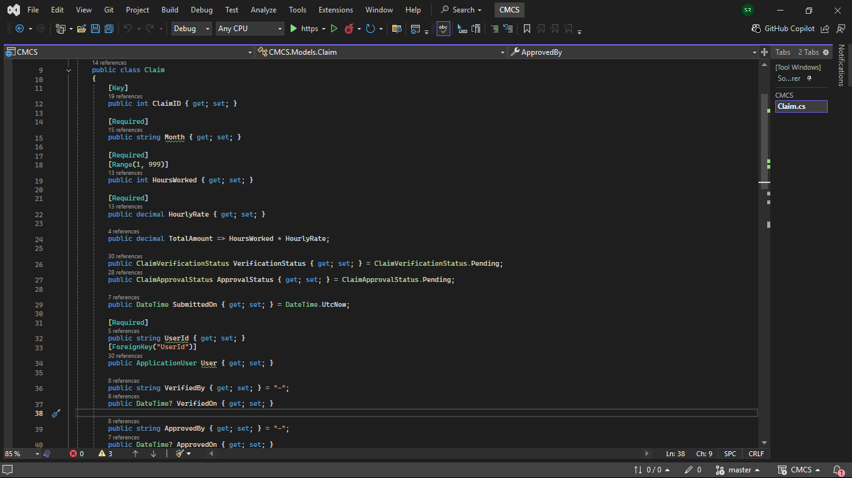
Claim Model

Slide 40
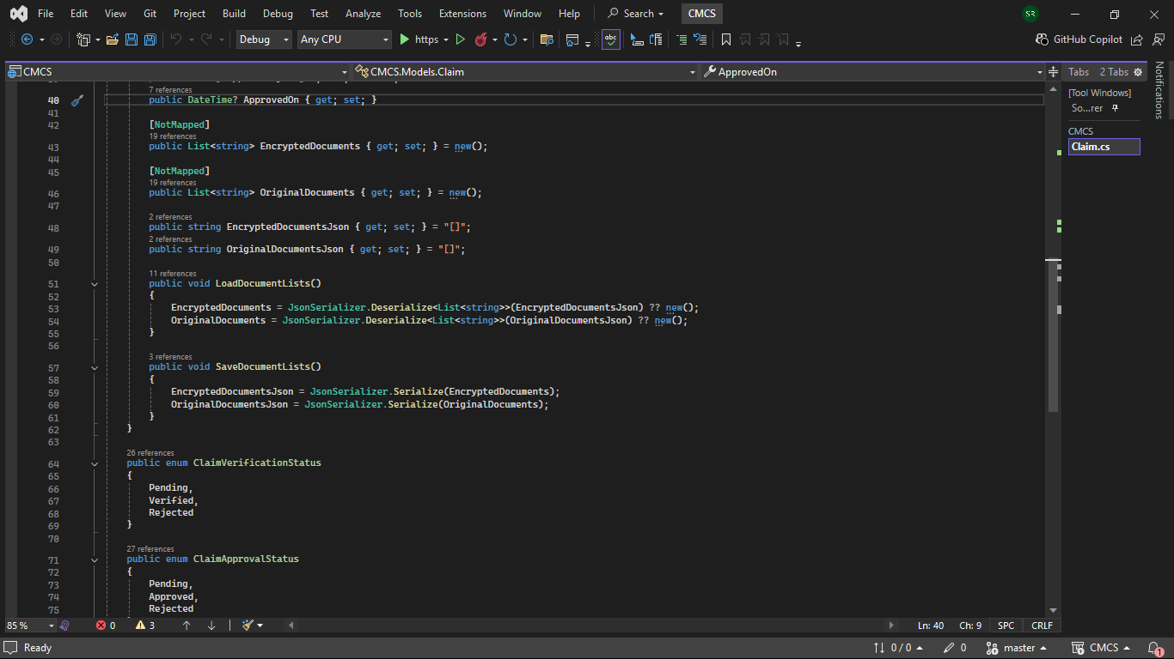
Claim Model

Slide 41
PDF Reporting
HR can generate…
Claim reports
Invoices for lecturers
Export as PDF using PdfSharpCore
Filters: date, status, or all claims

Slide 42
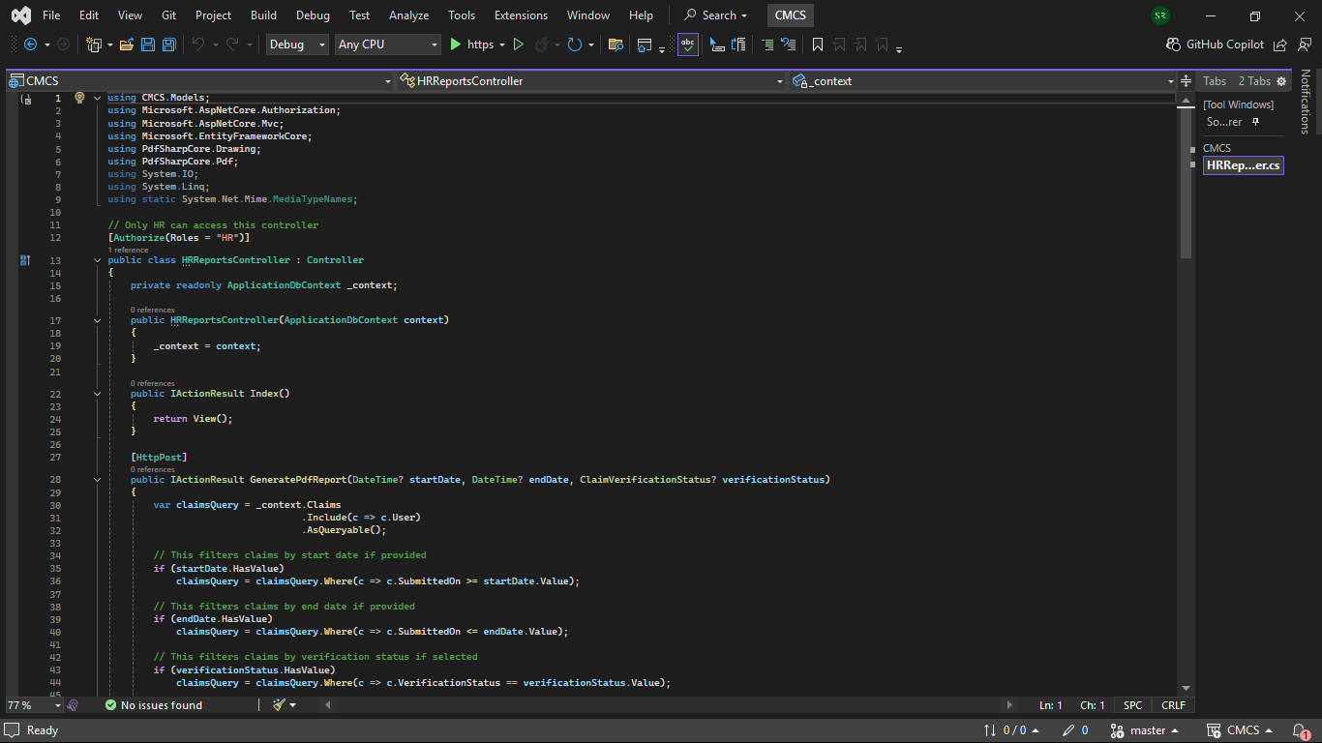
HRReports Controller

Slide 43
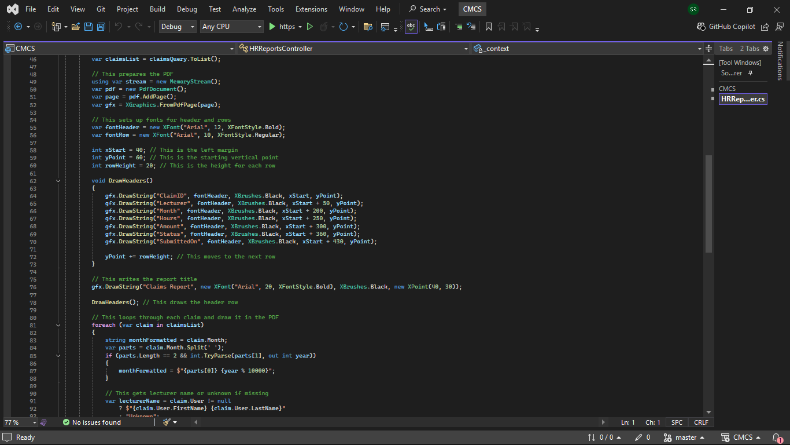
HRReports Controller

Slide 44
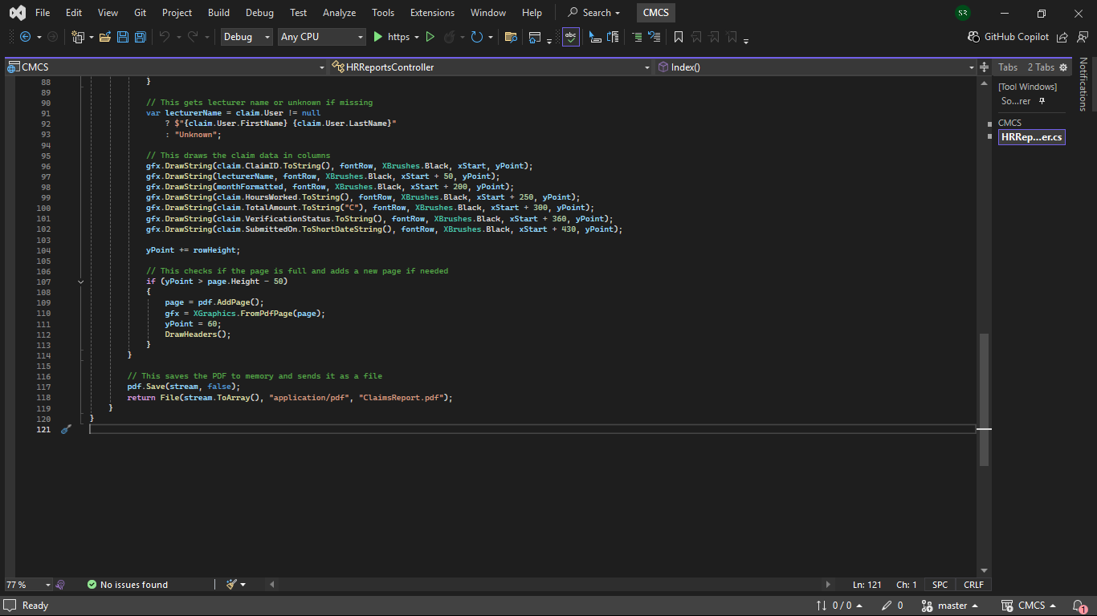
HRReports Controller

Slide 45
Code Explanation
If(startDate.HasValue)… if (endDate.HasValue)… if (verificationStatus.HasValue)… Filters the claims only if the user provides a value.
Void drawheaders() Manages the pages, when content reaches the bottom a new page is added.
using var stream = new MemoryStream(); pdf.Save(stream, false); return File(stream.ToArray(), "application/pdf", "ClaimsReport.pdf"); Generates the PDF in memory, converts it to a byte, and allows the browser to receive the PDF as a file download.

Slide 46
Security Validation
Authorization/enforcement via Identity
FileEncryptionService from Part 2 still in use
Validation: Hours, TotalAmount, Required fields
Prevents unauthorized access to pages

Slide 47
UI/UX Improvements
Consistent styling across views
Clear validation messages
Responsive layouts for dashboards and forms

Slide 48
Conclusion – Summary of Changes
Component | Part 2 | Part 3
HR | Basic user creation | Super user, full user info, PDF reports filtered by date/status
Lecturer | Manual entry | Auto-fill, auto-calc, EF claims, validation
Coordinator | Partial verification | Full verification workflow, session enforced
Manager | View all claims | Only verified claims, session enforced
Storage | In-memory | EF database
Security | Minimal | Authorization via Identity, FileEncryptionService in use
UI | Inconsistent | Consistent styling & validation
Reporting | None | PDF generation via PdfSharpCore

Slide 49
Thank you!

